Slide 1

Pricing Considerations for New York City hosts of Airbnb
March 23, 2020
Group 5: Thomas Bahng, Toni Hanrahan, Jason Kang, Michael Man
Notes:
Target audience of the presentation is hosts on Airbnb
Content will specifically address the concerns of hosts on the ground, not Airbnb policies like listing fees

Slide 2

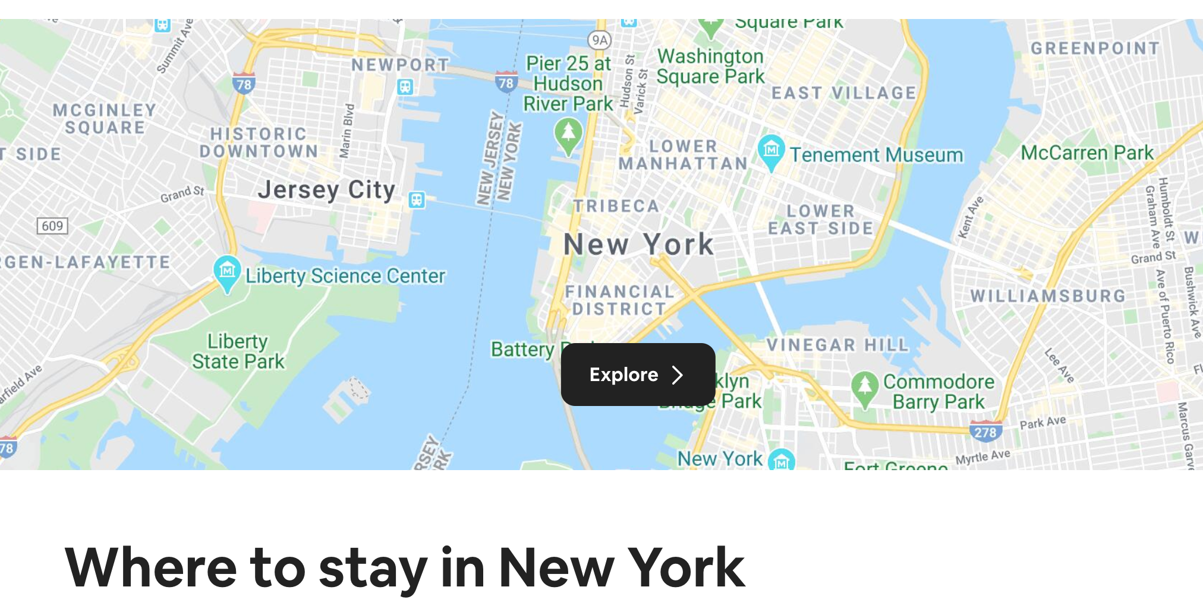

Platform to connect people (hosts) with overnight accommodations available with people (guests) seeking overnight accommodations
Facilitates electronic payment between hosts and guests
From the website:
Founded in 2008
Over 7 million listings worldwide
Over 100,000 cities with listings
Over 220 countries and regions with listings
As of December 2019
Over 50,000 listings in New York City
Listings in all five boroughs
Notes:
MM
Presentation will not address any of the social and economic issues such as availability of long-term housing

Slide 3
Industry Conditions
Annual growth in the “Bed and Breakfast and Hostel Accommodations” (NAICS 72119) is expected to be 2% from 2019 to 2024
Annual growth in “Hotels and Motels in New York” (NAICS NY72111) is expected to be 2.9% from 2019 to 2024
Attraction of New York City as an international destination known for being expensive means a greater willingness from consumers to pay more
High capital intensity, high competition, high cost of doing business, and market saturation means growth will come from efficient pricing
Notes:
MM
Analysis of the industry using Porter’s Five Forces shows:
High capital intensity - this is understandable as real estate prices in New York are among some of the highest in the world (Fleming, 2019)
High competition - from bed and breakfasts, hostels, hotels, motels, and vacation rentals of all caliber, there are many direct competitors and substitutes for Airbnb. (Le, 2019) (Hyland, 2019)
High cost of doing business
In addition to the 21% federal corporate tax rate, New York City has a business income tax of up to 8.85% and state corporate tax rate of 6.5% for a combined 15.35%. This is high even compared to Los Angeles, the next largest city based on GDP, which only has an 8.5% state corporate tax. (Cammenga, 2020) (Business Corporation Tax, 2020)
Queens, Brooklyn, and Manhattan (3 out of 5 boroughs) are among the ten most expensive places to live in the US (Burrows, 2019)
Key takeaway: It is important to have efficient pricing and a surgical approach to choice of property for Airbnb.

Slide 4
Competitive Characteristics
Customer-base range from young budget travelers to older business travelers. Many are seeking unique and “authentic” experiences
Uniqueness and authenticity are used by operators in the industry as distinguishing factors
Physical surroundings such as neighborhood contribute to uniqueness and atmosphere
Aside from proximity to landmarks and attractions, neighborhood personas are speculated to have an impact on pricing and demand
Notes:
MM
Like hotels, there is a diversity of options
Listings place private homes in direct competition with hotels and motels
Airbnb website highlights unique accommodations such as castles, treehouses, and tiny homes
New York is a destination city with 63 million annual visitors (Gonzalez-Rivera, 2018)
Personalities and perceptions of Lower Manhattan is different from Williamsburg

Slide 5
Objective
Help current and potential Airbnb hosts maximize profit in the New York City market with an analysis of the various aspects of pricing.
We will do this by answering the following questions:
How does Airbnb data compare with Prizm and Census data?
How do boroughs and neighborhood affect rental price?
How do reviews affect rental price?
What are segment/categories of rental properties and how do they affect price?
What are other main drivers that affect rental price?
Notes:
MM
How do reviews affect rental price? In other words, do better rated listings command a higher rental price?
Is current pricing efficient?
Where are the most profitable opportunities?

Slide 6
Research Plan and Methodology
Download and explore data.
Inside Airbnb - detailed listings
Prizm - DBSCAN used to get clusterings of listings based on their PRIZM features
US Census - Python library ‘uszipcode’
Analyze data.
Correlation analysis of variables against price.
K-Means segmentation and Principal Components analysis.
Statistical tests to assess variable significance to price.
Regression modeling of price and independent variables.
Summarize data.
Create visualizations.
Interpret visualizations.
Draw conclusions.
Provide recommendations.
Notes:
TB
Cleaned and transformed data as necessary for modeling.
Prizm data and neighborhood personas were clustered with DBSCAN.
Census data joined with listing data by zip code.
Data sets were split among multiple files.

Slide 7
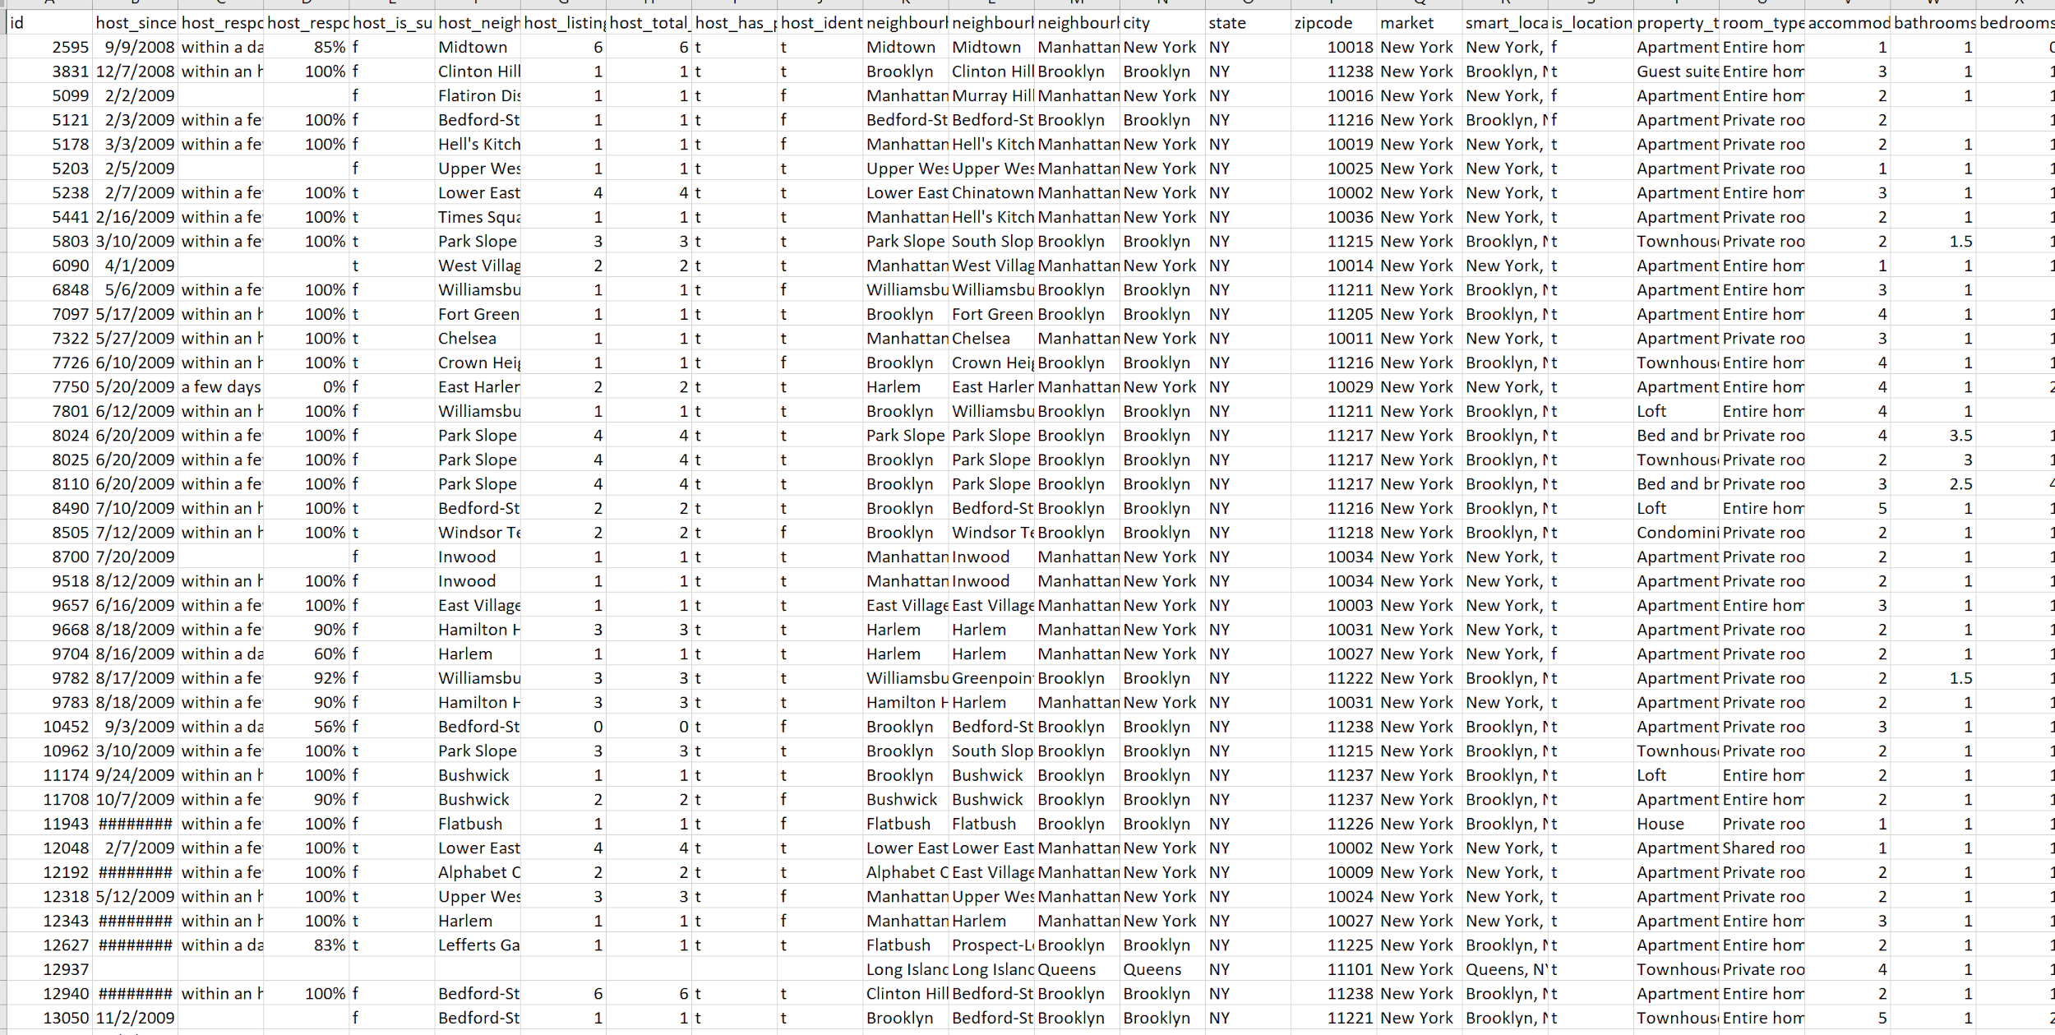
Data Overview
Inside Airbnb
Listings from 12/7/2019
50,599 observations
43 numeric variables
63 object variables
Prizm
188 zip codes
29 personas
Census
188 zip codes
Notes:
TB
Inside Airbnb is a third party site that scrapes Airbnb.com to compile data monthly.
Prizm data fit in the scope of the project.
US Census data was a secondary data source to provide additional context into neighborhoods.

Slide 8
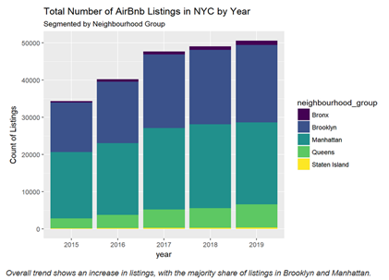
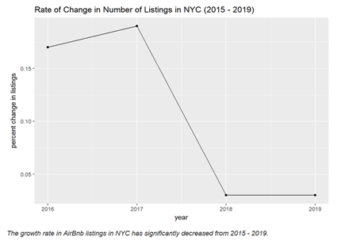
Explore: Overall Trends in Listing Activity
Overall trend shows an increase in total listings with majority share in Brooklyn and Manhattan.
The rate of growth in listings has decreased from 2015 - 2019.
Notes:
TB
Key takeaway: While the overall rate of growth in listings has decreased in the past four years, continued growth in Brooklyn and Manhattan seems to indicate that there is still incentive for competitors to enter the market in those specific boroughs, even if there is less incentive to enter the markets in Queens, the Bronx, and Staten Island.

Slide 9
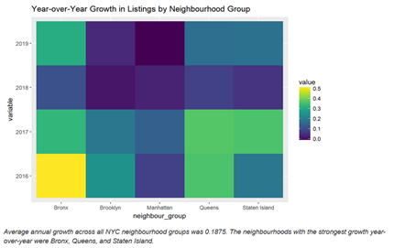
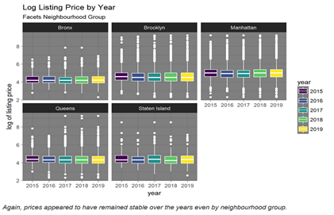
Explore: Growth Rates and Pricing Trends by Location
Average annual growth rate across all boroughs was 19%.
Strongest percentage growth year-over-year was in Bronx, Queens, and Staten Island.
Likely because there were fewer listings to begin with.
Year-over-year pricing remained stable across all boroughs.
Notes:
TB
Key takeaway: Low rates of change in pricing across all boroughs and for five years indicates a mature market at or close to equilibrium price.

Slide 10
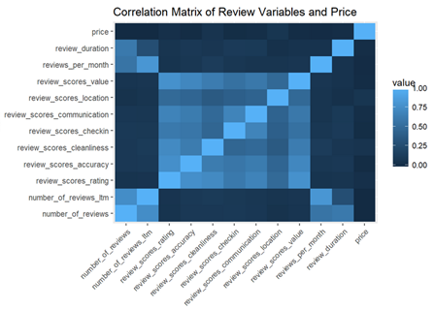
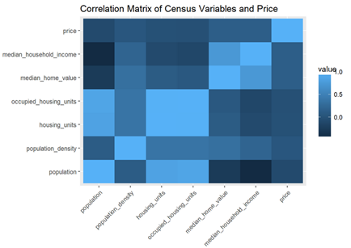
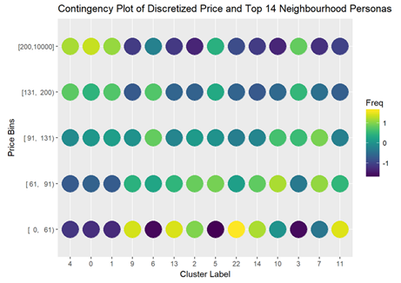
Explore: Relationships to Price
Price is not highly correlated with Reviews or Census attributes
As expected, some moderate correlation with home values and household income
Prizm attributes (low pricing):
Low-Rise Living | City Roots | Multi-Culti Mosaic | Multi-Culti Families | Urban Modern Mix
Prizm attributes (high pricing):
Young Digerati | Money & Brains | The Cosmopolitans
Notes:
TB
Price is not highly correlated with any of the review variables.
It probably means that hosts aren’t setting prices based on what people are saying about the rentals and pricing is more influenced by market forces/other factors.
Price isn’t highly correlated with Census attributes. Census attributes examined to supplement Prizm data.
However, as expected there is some moderate correlation between price, home value, and household income.
Key takeaway: There may be some truth to consumer preferences for “cool neighborhoods.” Young Digerati and Money and Brains descriptions both reference fashionable-ness and The Cosmopolitans are households with older homeowners, who are likely to be able to own in Manhattan.
Young Digerati - This segment is choosing to start families in fashionable neighborhoods on the urban fringe. They are highly educated and very tech-savvy.
Money and Brains - Many of these city dwellers have advanced degrees and are married couples with few children who live in fashionable homes.
The Cosmopolitans - Concentrated in major metro areas, these households feature older homeowners. They tend to be educated, married, and enjoy a leisure-intensive lifestyle.

Slide 11
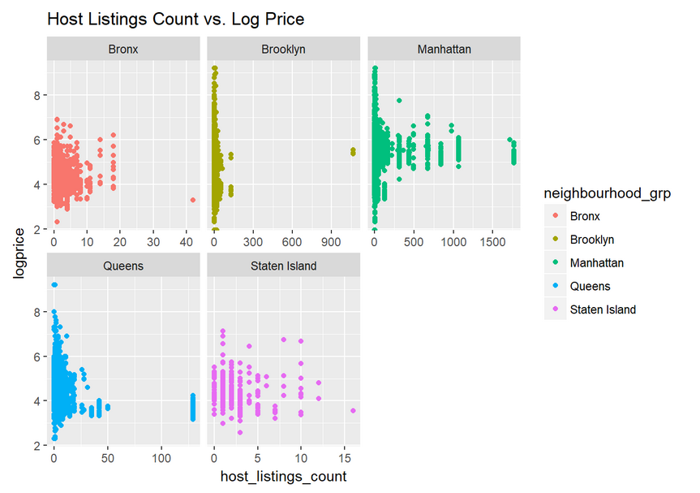
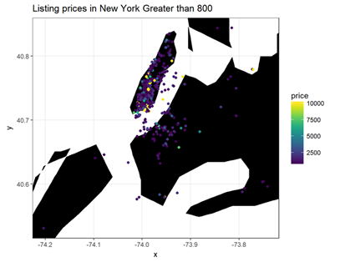
Explore: Pricing Behavior by Host | Top Priced Listings
Hosts with many listings tend to price more modestly.
Top pricing shown to be in Manhattan and Brooklyn.
West of Bushwick, north of Prospect Park
Majority of listings priced under $200.
Notes:
TB
Hosts that list many units on AirBnb generally tend to price more modestly than hosts with fewer listings to their name.
This is most clearly seen in Manhattan and Queens by the funnel-shaped visualizations.
It is not always the case as seen in the lower-tier neighbourhoods.
Here very few hosts have many listings, the market is not as saturated and the costs of doing business are not as high.
Most of the very high priced listings (i.e. greater than 99th percentile) are in Manhattan and Brooklyn neighborhoods across the Brooklyn and Manhattan Bridges.
The vast majority of listings in New York City are priced under $200 per night.
Key takeaway: Full time Airbnb hosts tend to price lower than hosts with fewer listings, possibly a difference in strategy due to scale of operations. It is interesting because this might be irrational; there are few, if any, economies of scale from having multiple units on Airbnb. An analysis of whether lower priced units enjoy a greater asset utilization ratio than those priced higher.

Slide 12
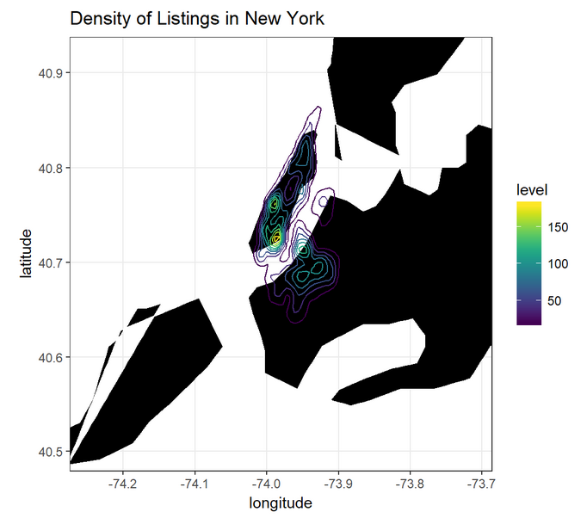
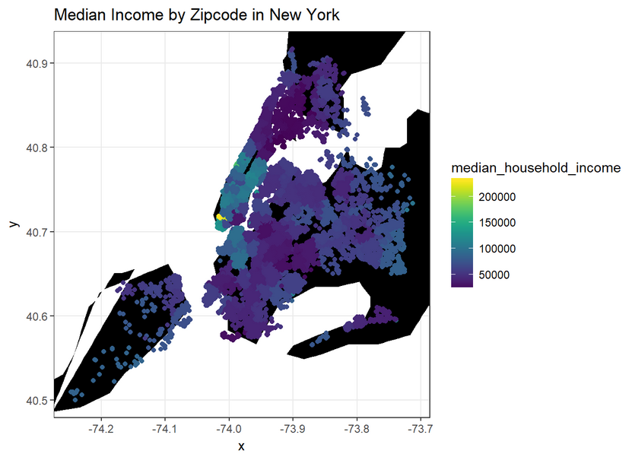
Explore: Mapping Listing Density and Median Income
Listings densely clustered in Manhattan and Brooklyn
Manhattan has the highest median household income, followed by north Brooklyn. Median incomes range between $130,000 to $200,000+.
Notes:
TB
Most listings are densely clustered in Manhattan and Brooklyn
Manhattan has the highest median household income, followed by north Brooklyn. Median annual incomes range between $130,000 to $200,000+. The other surrounding regions such as Staten Island, Bronx, and Queens are lower between $50,000 to $100,000.
Key takeaway: While it is possible that renters can list on Airbnb, it is likely that these relatively affluent areas with many entertainment options and attractions have more homeowners and therefore, have greater numbers of listings.

Slide 13
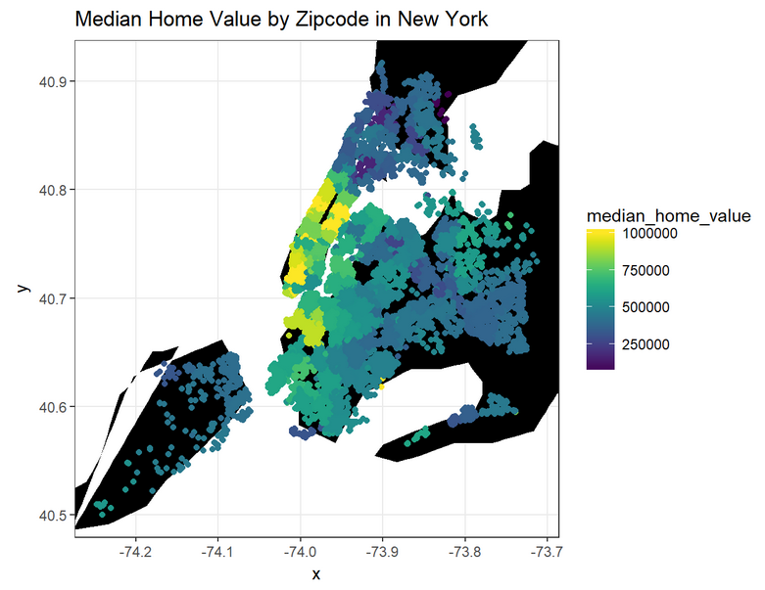
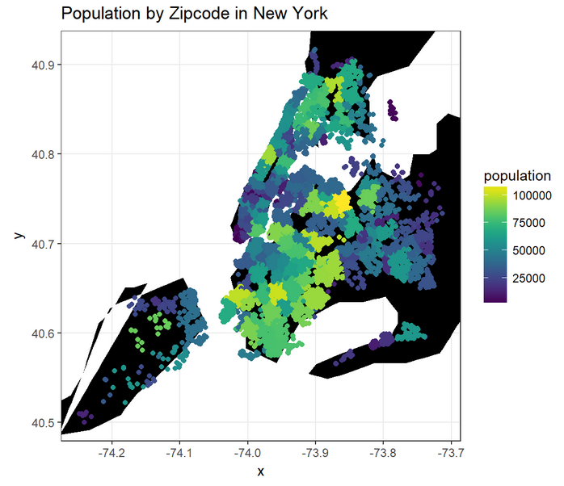
Explore: Mapping Median Home Value and Population
Most zip codes have median home values above $500,000 with a lower bound of about $300,000.
Most people live in vicinities surrounding Manhattan, contrasting with the high density of listings in Manhattan.
Notes:
TB
The median home value ranges between $500,000 and $1,000,000 in the vicinities of Manhattan, Brooklyn, and Queens.
Most zip codes exhibit median home values above $500,000 with a lower bound of about $300,000.
The listings in Manhattan are those in areas of high home values. Many of listings in Brooklyn are in areas with relatively lower home values.
The plot shows that most people live in the vicinities surrounding Manhattan, particular in Queens, Brooklyn, Bronx, and Staten Island. Therefore, listings in Brooklyn and Queens are situated in zip codes where most people reside, despite most of the listings being located in Manhattan, a place with high employment density.
Key takeaway: Airbnb listings tend to be located in areas with relatively lower permanent populations than other parts of New York City.

Slide 14
Effect of Reviews on Price
 | Number of Reviews | Rating | Listing Accuracy | Rental Cleanliness | Check-In Process | Location | Value
Effect
Key Takeaways:
Pricing is not correlated with reviews
Interpreted to mean hosts may not be adjusting pricing based on customer feedback
Relative impact of variables were the same for the variables above
Coefficients changed, but position on the list based on impact was the same
Two variables consistently had the most impact:
Location
Cleanliness
Notes:
JK
Reviews were used in the regression to determine what customers valued, to understand whether various aspects of reviews had any correlation to pricing.
Variables are on a zero to ten scale
Overall Rating is on a 0 to 100 scale
Variables include:
Number of reviews - sum of reviews given for a rental
Overall rating - average of all overall scores given for a rental
Accuracy of posting - a measure for how well a rental met customer expectations
Cleanliness - customers’ opinion of cleanliness of a rental
Check-in process - the ease of getting into the rental
Communication - how well the customer felt communication with the host was during the transaction
Location - customer convenience for getting where they need to go from the rental
Value - customer opinion for whether there were net benefits received from the rental compared to the costs
Regression model
NAs were omitted
Adjusted R-Squared was never above 0.2
Multiple models attempted, including:
Entire home rental segment
Private room rental segment
Shared room rental segment
Log transformation of dependent variable
Value has a negative impact likely because the greater value is rated, the cheaper the listing.
Number of reviews has a negative effect likely because the greater the number of stays, the greater the chance of something not having met expectations.
Check-in process has a negative effect likely because a lower priced walk-up with a lockbox for the key is easier to get in than a higher priced building with a doorman.
Effect of listing accuracy means the higher the accuracy, the lower the price.
This is counter-intuitive
Might mean that lower priced rentals embellish or oversell less, but it could also mean that higher priced rentals tend to not meet expectations
Key takeaway: Reviews cannot be used to estimate pricing, but this information could be used to better inform how listings are presented and could be the basis for pricing experiments.

Slide 15
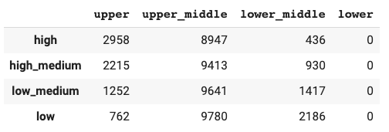
Effect of Neighborhood on Price
Neighborhood
Price
Neighborhoods are group by upper, upper_middle, lower_middle, and lower according to Prizm data.
Price are group by high, high_medium, high_medium, lower_middle, and low
Notes:
JK
Purpose of analyzing the data by neighborhood is to determine whether neighborhood has an effect on price.
The result will give renter (i.e. one who rents property to other) a better understanding of where and what to purchase rental property
Key takeaway: Upper neighborhoods have a higher ratio of high-price rentals while lower neighborhoods have a higher ratio of low-price rentals.

Slide 16
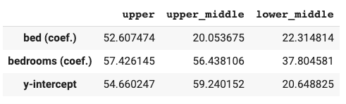
Effect of Neighborhood on Price: Using Bed and Bedroom as Control Variables
Y = price
X = bed, bedrooms
Group by neighborhoods (i.e. upper, upper_middle, lower_middle)
Notes:
JK
Key takeaway: For high-end neighborhoods, rental price grows faster with an increase in the number of bed and bedroom. This is the effect of neighborhood on price.

Slide 17
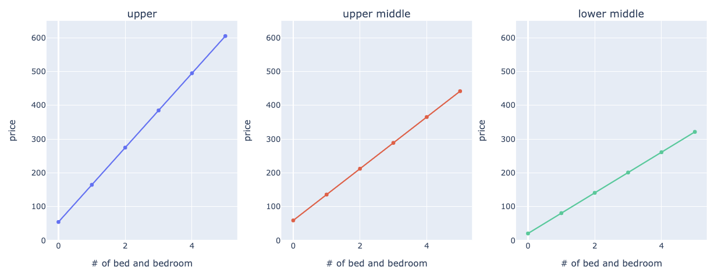
Plot of Price vs Beds and Bedrooms
Assume number of bed = number of bedroom
Notes:
JK
Key takeaway: Rental prices in upper neighborhoods grow at a faster rate than those in lower neighborhoods with the increase in beds and bedrooms.

Slide 18
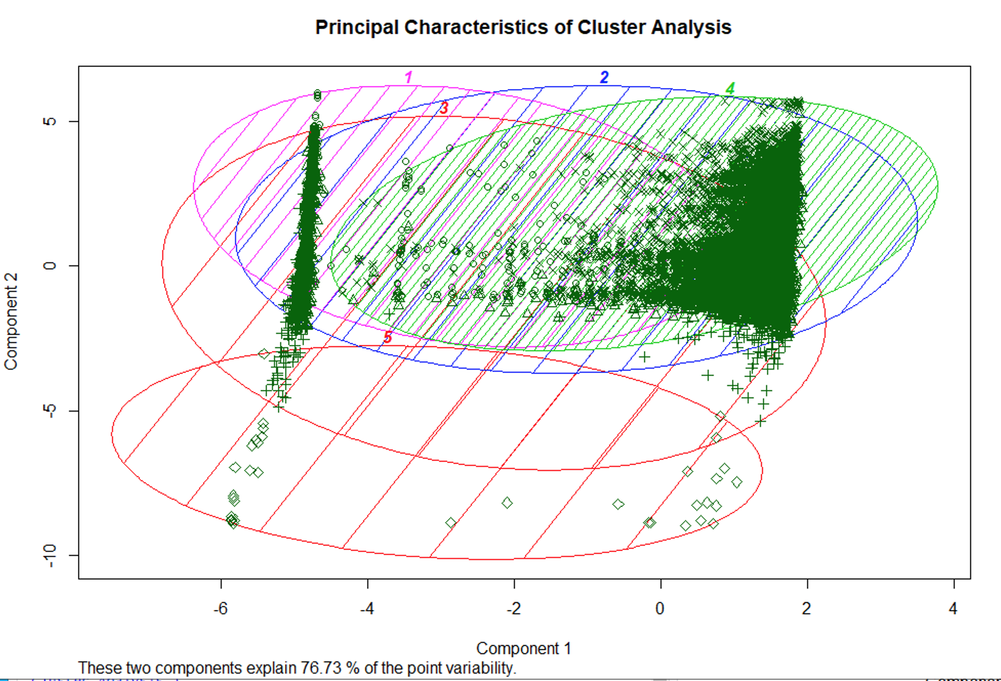
Effect of Segmentation on Price
K Means Clustering and Principal Components Analysis was conducted
Five distinct clusters were identified
Some overlap but reasonable separation
Variables used for clustering have been reduced to remove correlation
Notes:
TH
Principal components analysis (PCA) is an analysis of the covariance matrix of the variables to determine how much of the variability in the data can be explained by a reduced dimensionality set of basis vectors that are not correlated.
It's a way of detecting and removing correlation from your original set of data factors.
The clusplot shows the 2 largest principal components as the X and Y axes, and plots the data points (green symbols) in terms of the value of the first and second principal component.
It also shows the percentage of variability in the data that can be explained by the first 2 principal components. The ellipses are the shape of the regions covered by the clusters in terms of the principal components.
So the clusplot is a visualization of how separable or not the clusters are (lots of overlap between the ellipses means they are not very well separated, so the clustering did not work very well) and how much redundant information is in your data set.
Key takeaway: Five distinct clusters were developed based on Neighbourhood Groups, Accomodations, Price, Review: {Ratings, Review Accuracy, Cleanliness, Check In, Communication, Location, Value}, and PRIZM Cluster

Slide 19
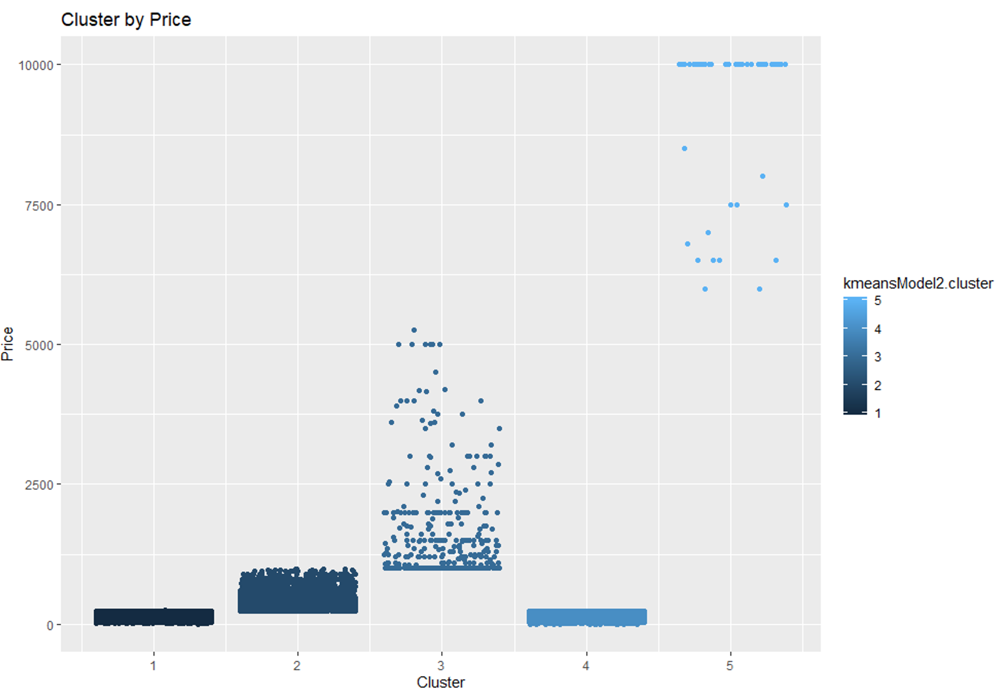
Effect of Segmentation on Price
Summary: Rental in the same cluster tend to rent for similar price ranges
Cluster 3 and 5 are more dispersed
Clusters 1 and 4 have a similar price range
Notes:
TH
Five distinct clusters were developed based on Neighborhood Groups, Accomodations, Price, Review: {Ratings, Review Accuracy, Cleanliness, Check In, Communication, Location, Value}, and PRIZM Cluster
Key takeaway: Clusters 1 and 4 appear to be more price sensitive.

Slide 20
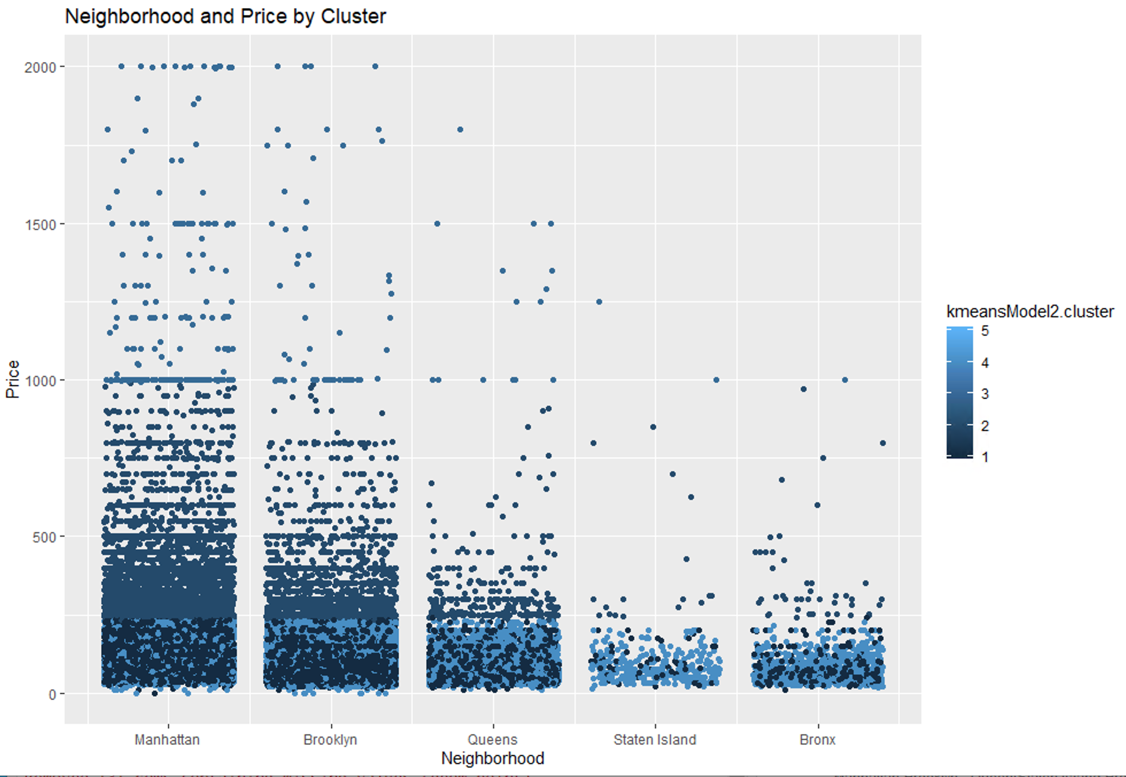
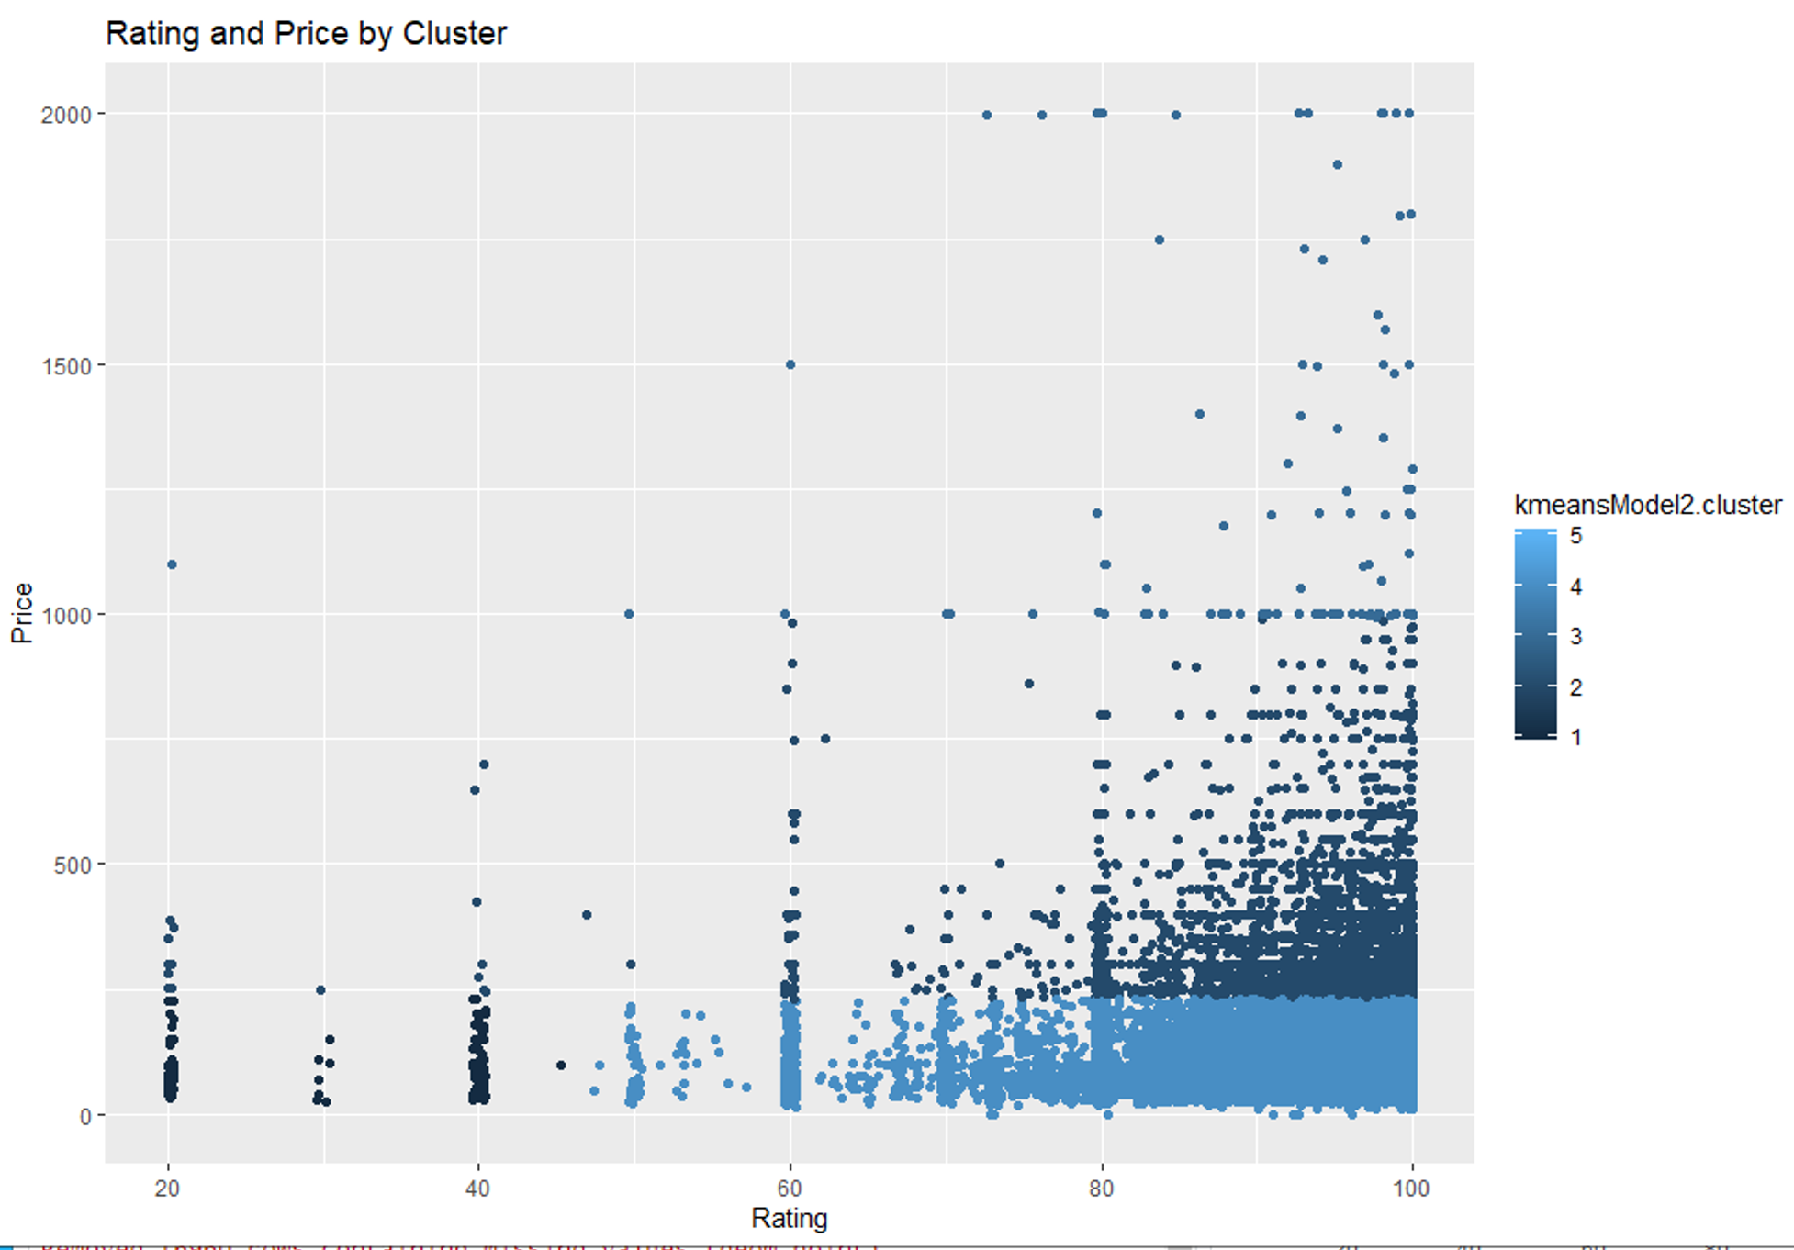
Effect of Other Factors on Price
Summary: Borough, review rating and price tend to cluster together
Clusters are more dispersed across boroughs
Review ratings and price cluster more closely
Notes:
TH
Other charts that displayed price/Prizm cluster or other ratings (cleanliness, accuracy, etc) did not show any informative trends or insights.
Key takeaway: There are few differences in pricing between Manhattan and Brooklyn.

Slide 21
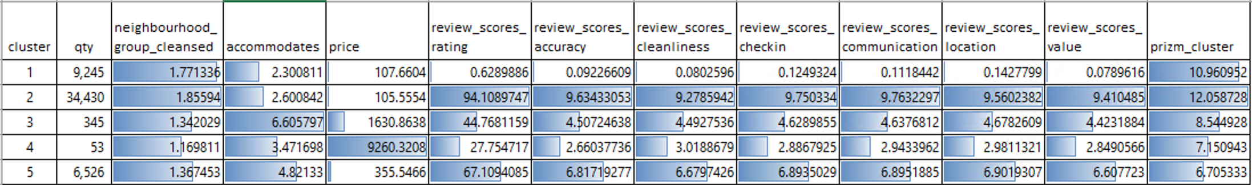
Other Observations About Clusters
Mean of each variable by cluster:
Summary: Cluster 2, 3 and 5 are the optimal segments to use for targeting
Cluster 1 represents new, or extremely low rated properties
Cluster 4 is a very small group of extremely high priced properties (i.e. luxury boutique hotels) and may be considered outliers
Notes:
TH
Cluster 4 is atypical and should be considered an outlier
Cluster 1 are mostly new properties or those with extremely low ratings and not easily grouped into any other cluster
Reviews may not affect the bulk of the listings but seems to have an effect on listings with extremely low ratings
Key takeaway: For the purposes of activating a marketing strategy, using Clusters 2, 3 and 5 would be the most lucrative target segments.

Slide 22
Conclusion
How does Airbnb data compare with Prizm and Census data?
No clear correlation
How do boroughs and neighborhood affect rental price?
High-end neighborhoods see faster increases in price based on some variables
How do reviews affect rental price?
Reviews do not affect rental price
What are segment/categories of rental properties and how do they affect price?
Based on geography and number of beds and bedrooms
What are other main drivers that affect rental price?
Beds and bedrooms
Location
Cleanliness
Notes:
MM
Manhattan and Brooklyn are priced higher
Queens and the Bronx have potential
Staten Island not as much

Slide 23
Recommendations
Buy property in Queens and the Bronx
Focus on high-end neighborhoods
Cluster properties if possible
Fill it with beds
Queens: Locations near the National Tennis Center or the Rockaways
Bronx: Locations near Yankee Stadium and Bronx Zoo
Price similarly to other properties in the neighborhood, based on beds, bedrooms, and bath
Label the listing with the location and include the word “clean”
Watch out for new entrants with significant capital
Notes:
MM
Difficult to add new bedrooms but rollaway beds and folding bed purchases will likely be offset by the faster growth
Focus on concentrated growth
Staten Island also a potential growth area but is less desirable location
Queens especially has lower median home values, meaning less capital is needed
Market only in equilibrium based on current conditions. Significant events, such as a drop in interest rates making capital easier to access, could affect the balance
Many small players in the market likely means less likelihood of a price war, but influx of capital could upset the balance

Slide 24
Works Cited
Aydin, R. (2019, September 20). How 3 guys turned renting air mattresses in their apartment into a $31 billion company, Airbnb. Business Insider.
Burrows, D. (2019, April 26). 20 Most Expensive U.S. Cities to Live In. Kiplinger.
Business Corporation Tax. (2020, March 7). Retrieved from NYC Department of Finance: https://www1.nyc.gov/site/finance/taxes/business-corporation-tax.page
Cammenga, J. (2020, March 7). State Corporate Income Tax Rates and Brackets for 2020. Retrieved from Tax Foundation: https://taxfoundation.org/state-corporate-income-tax-rates-brackets-2020/
Claritas. (2020, March 16). Zip Code Lookup. Retrieved from Claritas: https://claritas360.claritas.com/mybestsegments/?_ga=2.191688681.2124823222.1579060196-470179875.1579060196#zipLookup
Eaglesham, J., Farrell, M., & Grind, K. (2020, February 11). Airbnb Swings to a Loss as Costs Climb Ahead of IPO. The Wall Street Journal.
Fleming, S. (2019, March 11). The world’s most expensive places to own a home. Retrieved from World Economic Forum: https://www.weforum.org/agenda/2019/03/the-worlds-most-expensive-places-to-own-a-home/
Frommer, P. (2020, February 29). Neighborhoods in Brief in New York City. Retrieved from Frommer's: https://www.frommers.com/destinations/new-york-city/planning-a-trip/neighborhoods-in-brief
Gonzalez-Rivera, C. (2018). Destination New York. New York: Center for an Urban Future.
Hyland, R. (2019). Hotels & Motels in New York. IBISWorld.
Inside Airbnb. (2019, December 4). Get the Data. Retrieved from Inside Airbnb: http://insideairbnb.com/get-the-data.html
Le, T. (2019). Bed & Breakfast & Hostel Accommodations in the US. IBISWorld.

